Slide 1

Do Badges Effect Innovation Efforts on GitHub
Tim Toth
Eco 590

Slide 2
Motivations
Today, over 90% of all Fortune-500 companies use open source products (Github, 2022)
At the same time, monetary incentives might crowd out intrinsic motivation (Bénabou and Tirole, 2003)
In tandem with the rise in importance of open source for machine learning, we have also come to observe a decline in the value of information technology (IT) patents.(Acikalin, U.U, Caskurlu, 2022)

Slide 3
Research Questions
Estimate the impact of a user having an achievement on open-source innovation
Asses the relationship b/w receiving their first achievement and creating new repositories

Slide 4
Key Variables
Repositories
Commits
Issues
achievement

Slide 5
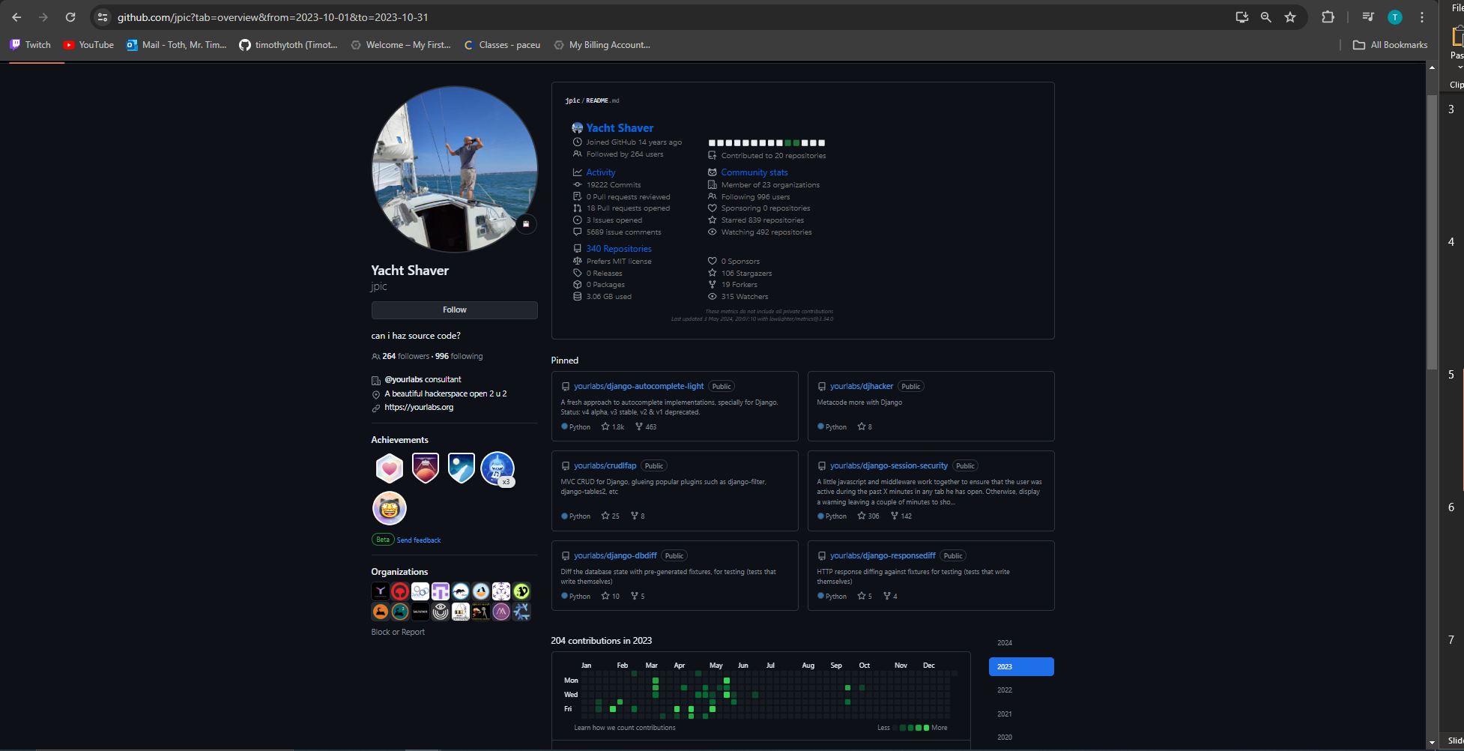
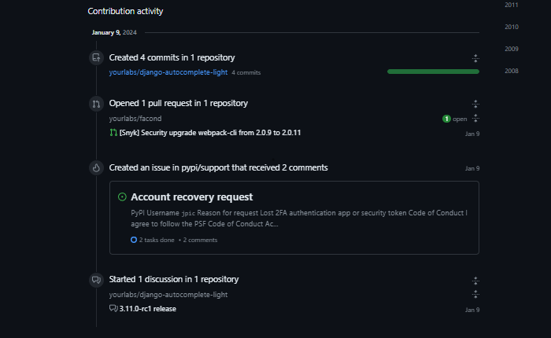
GitHub

Slide 6
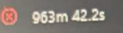
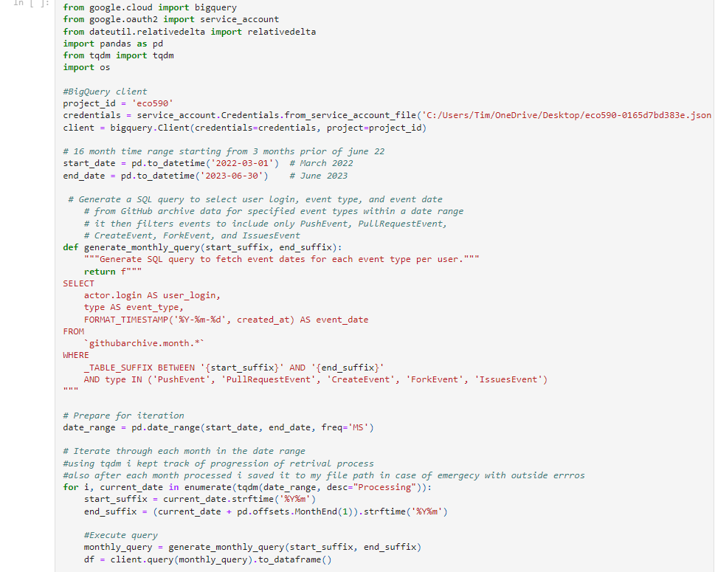
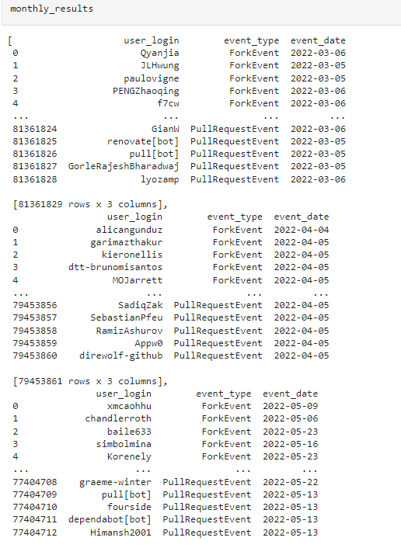
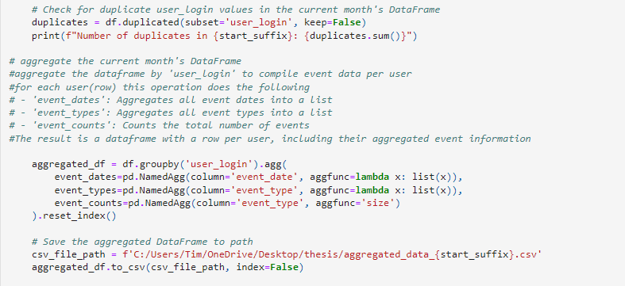
Data Gathering from bigquery

Slide 7
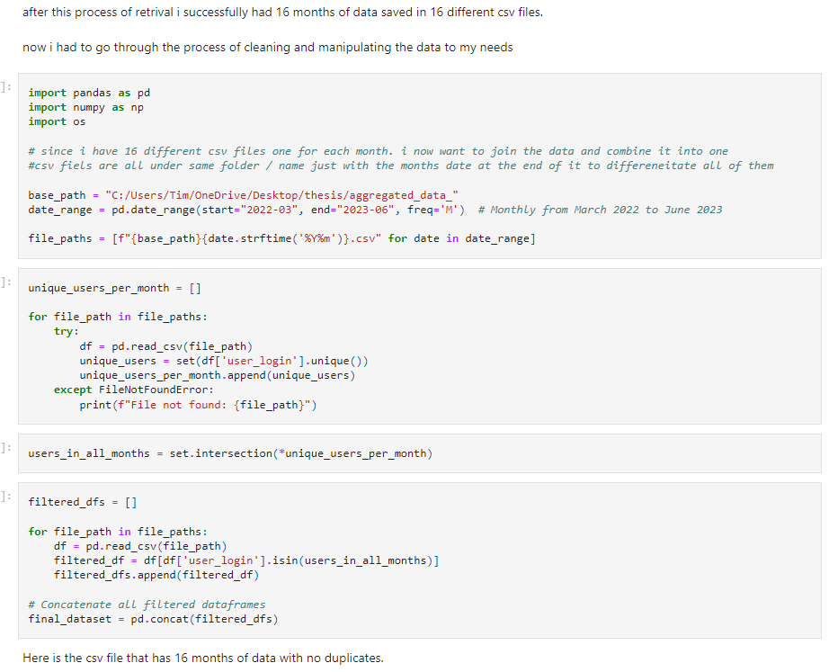
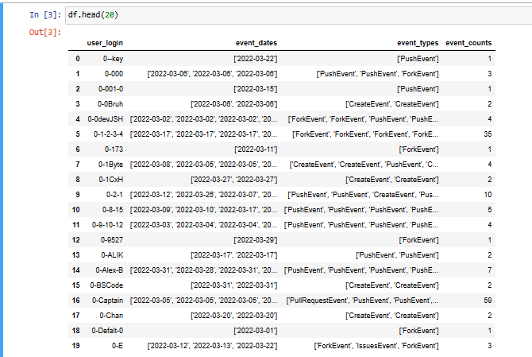

Slide 8
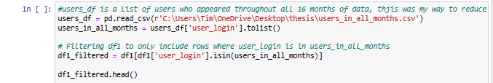
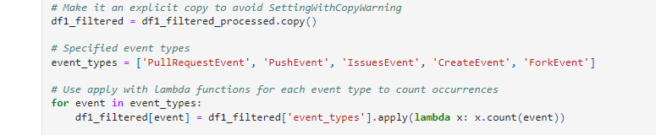
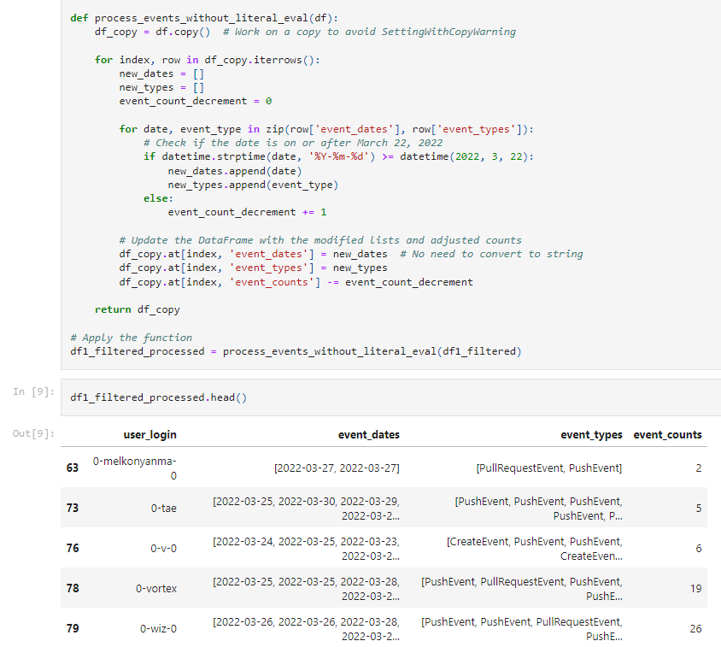
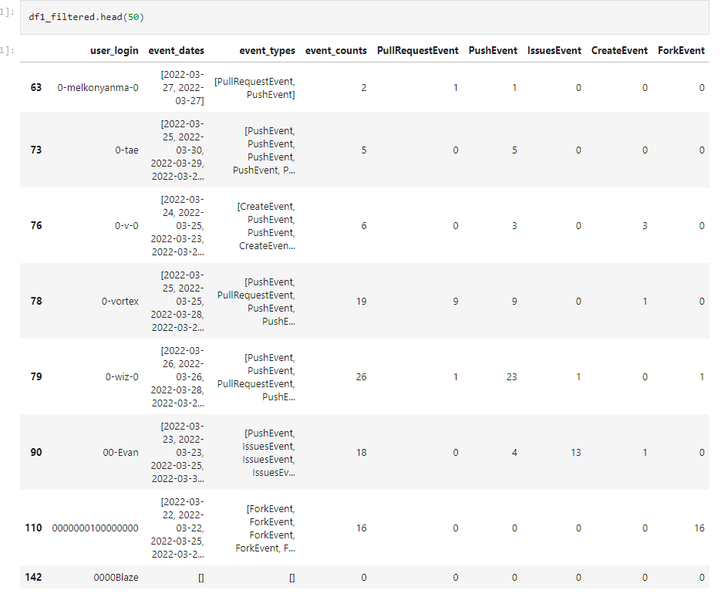

Slide 9
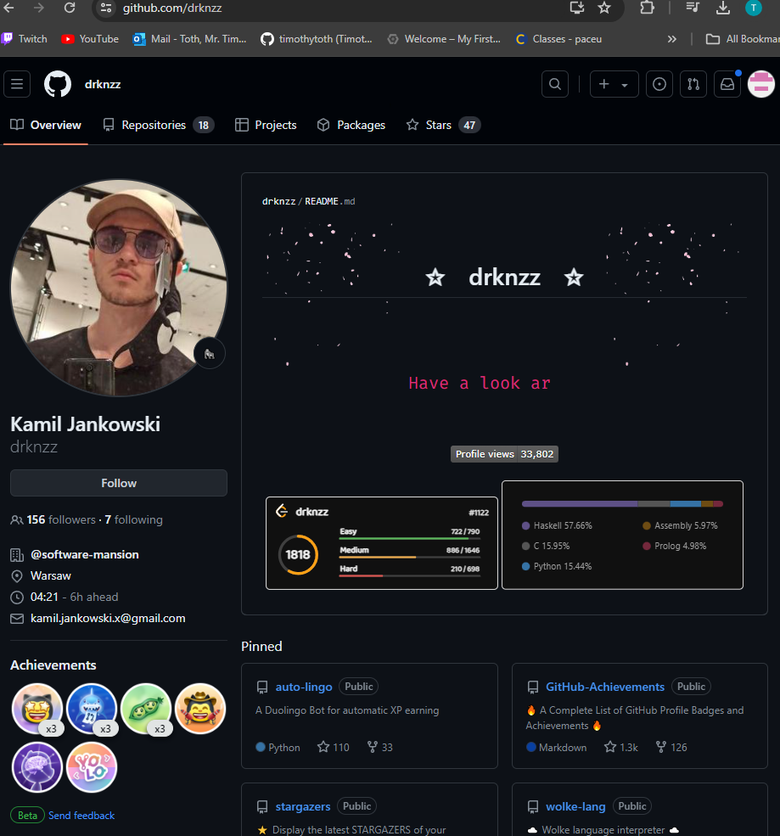
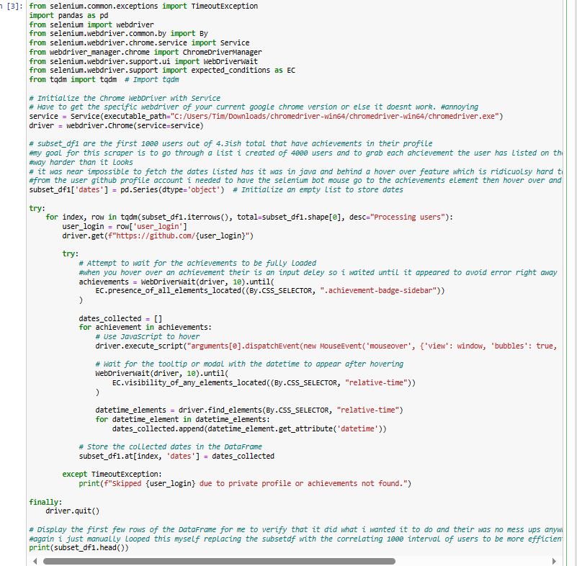
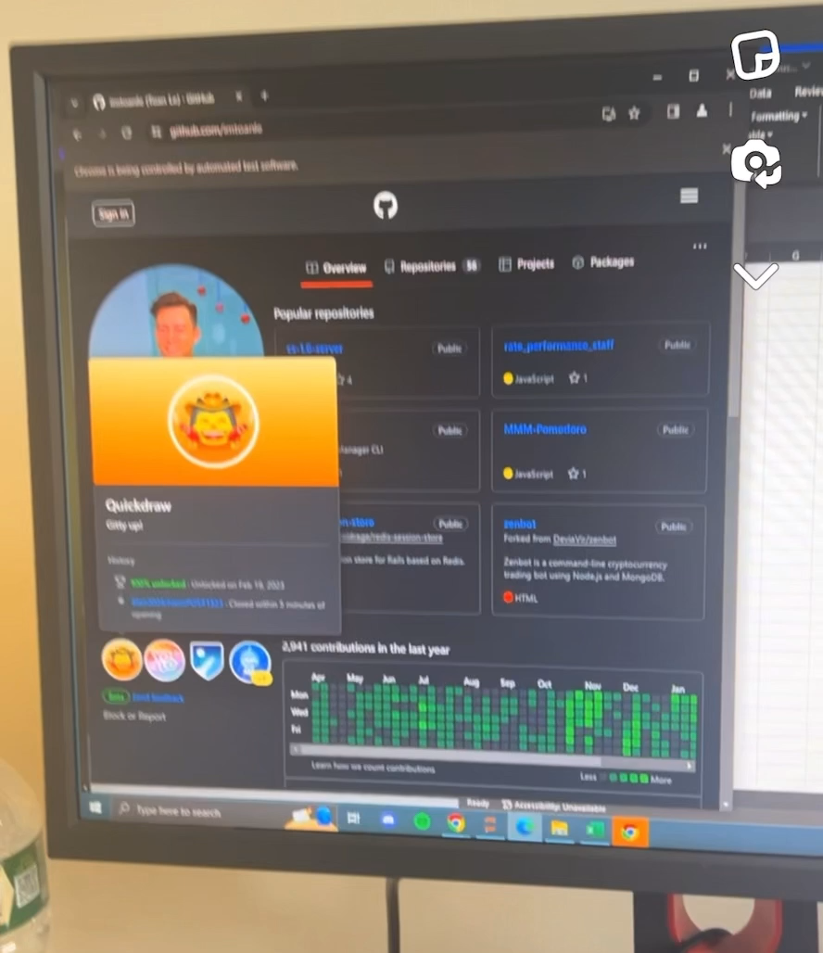
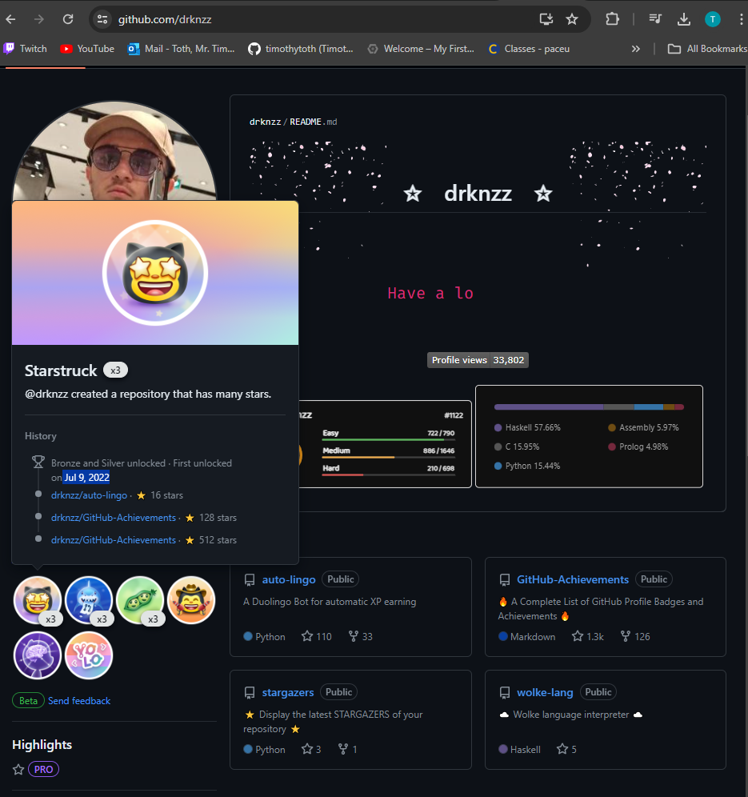
webscraper
<relative-time datetime="2022-07-09T16:14:12Z" month="short" day="numeric" threshold="PT0S" title="Jul 9, 2022, 12:14 PM EDT">
2022-07-09 12:14:12 -0400
</relative-time>

Slide 10
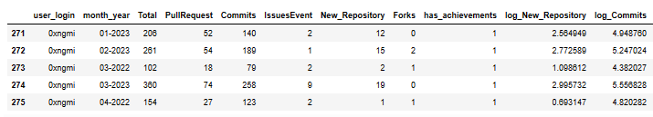
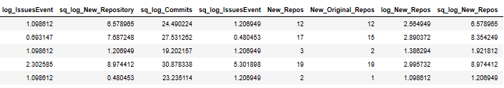
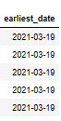
Final dataset

Slide 11
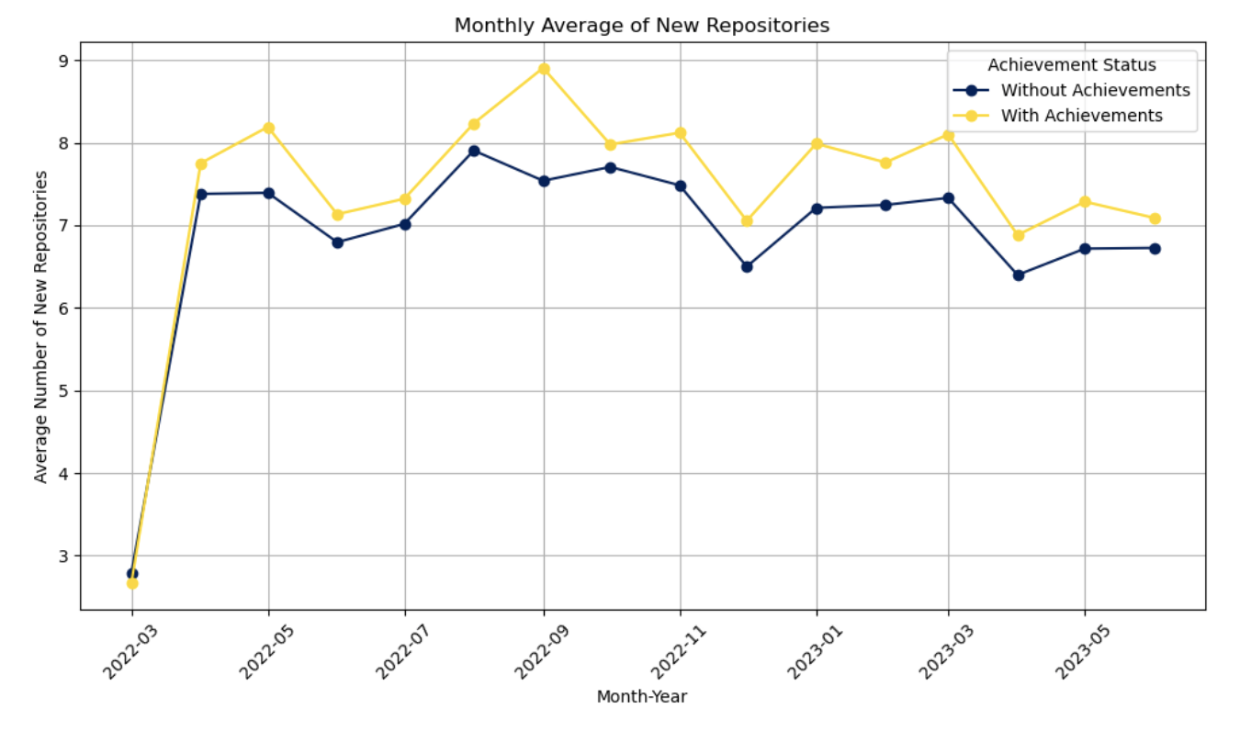
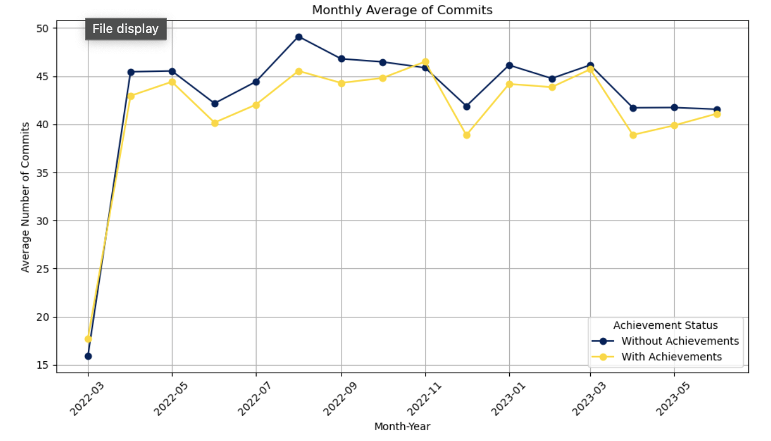
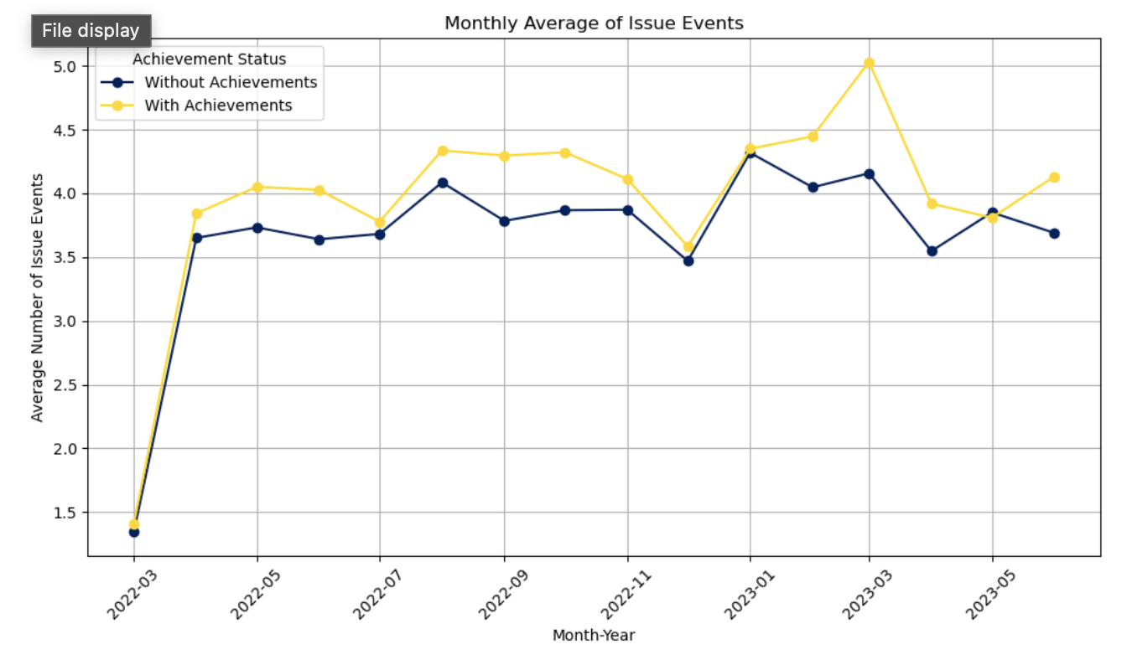

Slide 12
Propensity Score (IPW)
Estimated a probit model, to predict each user's probability p of receiving the treatment given pre time period baseline observational characteristics
log(p/1-p) = exp(

Slide 13
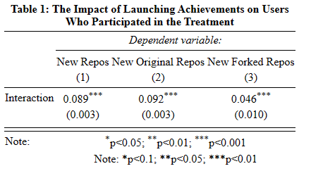
Regression
E(Yit|Xit) = γi exp(β · has_achievementi · I[t > June 2022] + τt)

Slide 14
Discussions
Table 1 shows three columns alternatively having New Repos, New Original Repos, and New Forked Repos as dependent variable
The interaction term is having achievements inside the post treatment

Slide 15
Conclusion and Future Study

Slide 16
Source
https://www.gharchive.org

Slide 17
